Slide 1
SharePoint 2010 Development with Visual Studio 2010
MVP Nguyễn Bá Quang
Hà nội, 13/4/2010

Slide 2


Evolution of SharePoint Tooling
VS2005
VS2008
VS2010
+
+
F5 Deploy Debug
WSP Packaging
SPSolGen
WSP View
Sequential Workflow
State Machine Workflow
64 bit support
WSP View Improved
Separate Package Command
Command Line Build
Multiple Visual Designers
Packaging and Deployment
Project & Item Templates
TFS integration
Extensible Projects & Tools
VSeWSS
VSeWSS 1.3
Upgrade Tool
2007
2008
2009
2010

Slide 3
Visual Studio SharePoint Support Development environment requirements
Requires x64 operating system
Windows 7
Windows Vista SP1
Windows Server 2008
Windows Server 2008R2
SharePoint 2010 must be installed locally
SharePoint Foundation or SharePoint Server
Visual Studio 2010

Slide 4
Visual Studio SharePoint Support Templates and designers
Project and Item Templates
Templates for many SharePoint elements
Support for sandboxed solutions
Visual Designers
Design web parts
Build Business Data Connectivity (BDC) models
Create Workflows
Workflow Enhancements
Site level workflows
Templates for association & initiation forms

Slide 5
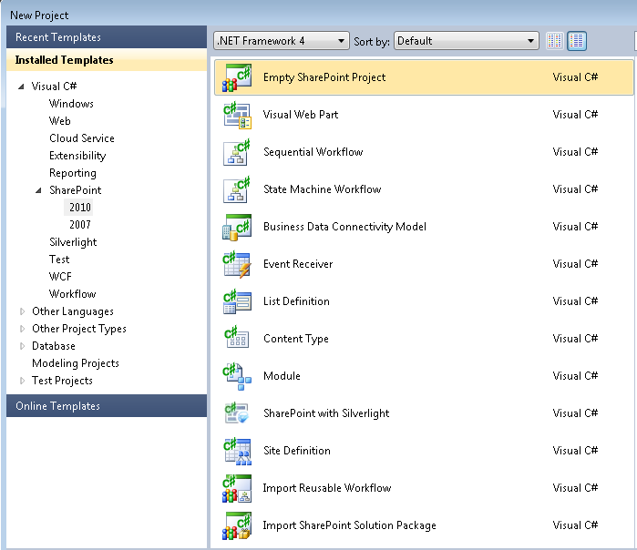
Project Templates

Slide 6
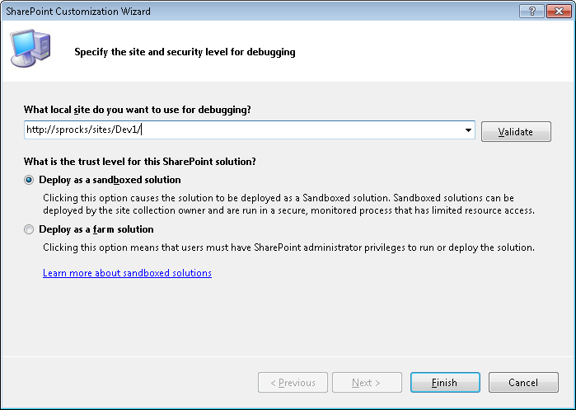
Project Wizard
Site used to deploy & debug solution
Support for sandboxed solutions

Slide 7
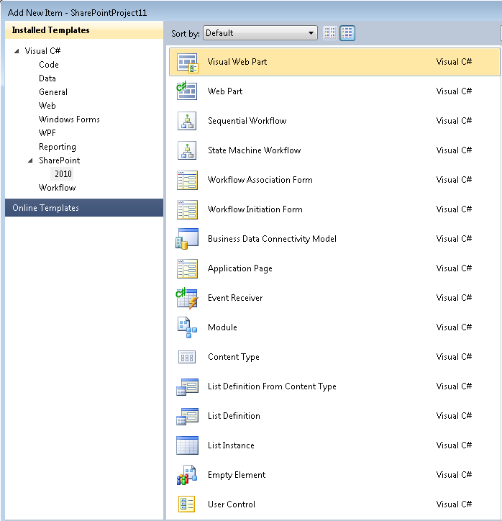
Item Templates

Slide 8
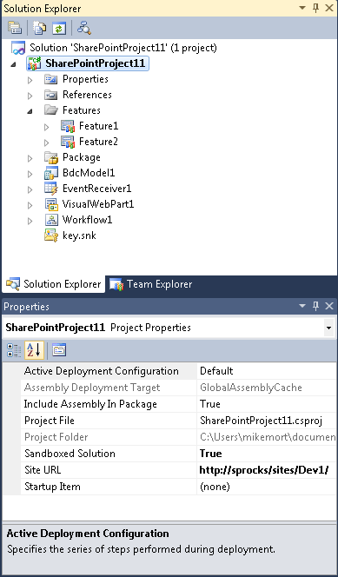
Visual Studio SharePoint Support Project system
Project commands
Package, Retract
Project properties
Sandboxed, Site URL, etc…
Features & Package nodes
Mapped folders
Project items & files have SharePoint specific properties

Slide 9
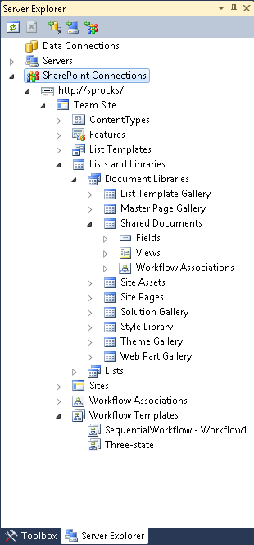
SP Connections in Server Explorer
Tool window which provides hierarchical view of local SharePoint sites & artifacts
View site collections, sites, features, lists, fields, etc…
View properties for artifacts
Add any number of connections to different site collections

Slide 10
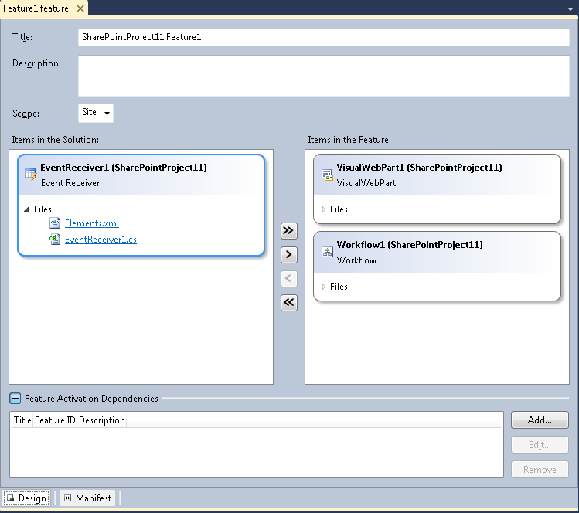
Feature Designer
Key feature properties
Add/Remove items to feature
Feature Activation Dependencies
View/Edit Feature XML

Slide 11
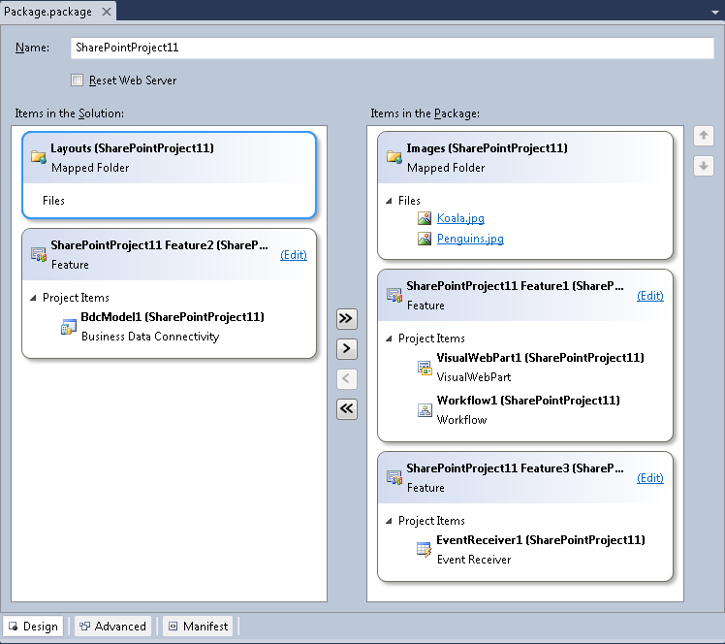
Package Designer
Package name
Add/Remove items & features
Add assemblies, safe controls, resources
View/Edit Package Manifest

Slide 12
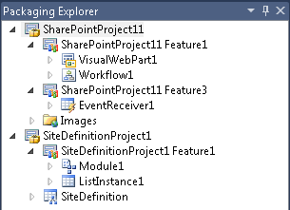
Packaging Explorer Project and Items
Packages
Packages
Features
Features
SharePoint Project Items (SPIs)
SharePoint Project Items (SPIs)

Slide 13
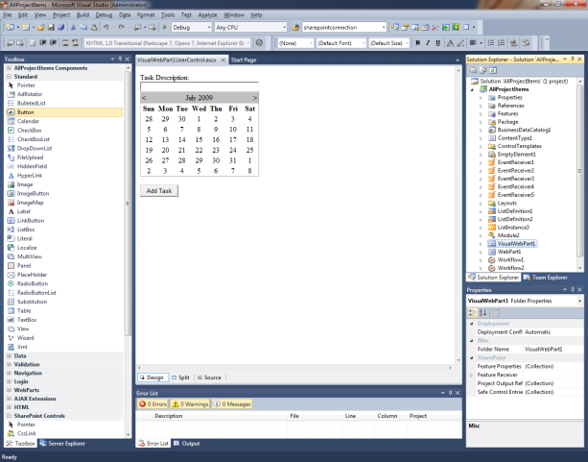
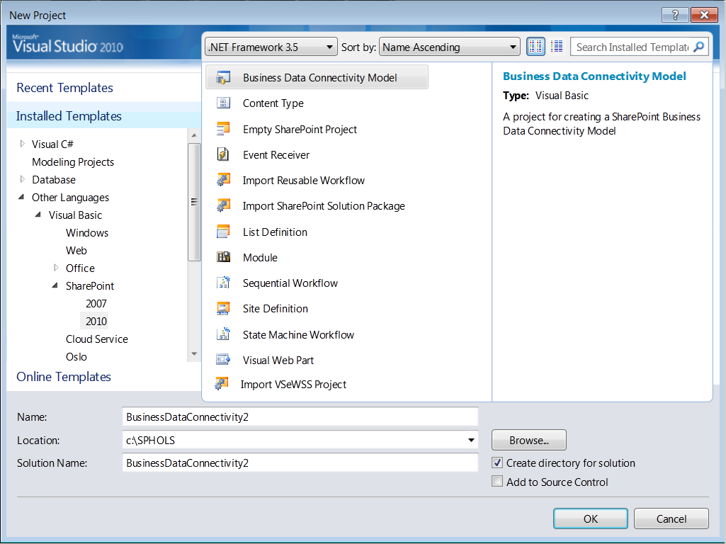

Summary - Visual Studio 2010 Developer Tools for SharePoint
Develop, Deploy and Debug
Web Part, BDC and Workflow designers
Package and Deploy SharePoint projects
Generate WSP for Production Deployment
View SharePoint site in Server Explorer
Team Foundation Server Integration
Web Part Designer
Broad SharePoint Support
Support for SharePoint Sandboxed Solutions
Import WSP from SharePoint Designer including Workflow
Build Workflow Steps for SharePoint Designer
Extensibility for Development of Additional SharePoint Artifacts
SharePoint Business Connectivity Services support
Project Types

Slide 14
New way to work with SP Data
REST APIs
Strongly-typed lists
Client OM
Client-side
Weakly-typed lists
Data Platform
Farm
Site
List Data
External Lists
Server OM
Server-side
Weakly-typed lists
LINQ
Strongly-typed lists
New in 2010
Improved
Notes:
Strong-typing vs Weak-typing
Strong type is checking the types of variables at compile time. Weak typing is checking the types of the system at run-time. For scripts we will use weak typing. In big programs,we will use strong typing which can reduce errors at compile time

Slide 15

LINQ to SharePoint Language Integrated Query
Entity based programming
Strong Types and Intellisense
Supports List Joins and Projections
Join lists on lookup field between them
Join multiple lists (A->B->C)
Project any field from joined list in a query without changes in list schema
Example
from o in data.Orders where o.Customer.City.Name == "London“ select o;

Slide 16
Client Object Model Runs on Remote Machine
Simple API to Add, Retrieve, Update and Manage Data in SharePoint
Commands batched for Performance
SharePoint Data
Consistent
Efficient
Client Application
.NET CLR
Silverlight CLR
JavaScript

Slide 17
Using the Client OM
JavaScript
Controls
JavaScript
Logic
JavaScript OM
JSON response
Proxy XML
XmlHttpRequest.post
Client.svc
Server OM
Web Browser
Proxy XML
HttpWebRequest.post
JSON response
Managed OM
Content
Database
Managed
Controls
Managed
Logic
Managed Client
SharePoint Server

Slide 18
Client Object Model Sample .NET
ClientContext context =
new ClientContext("http://server");
Web site = context.Web;
context.Load(site);
context.ExecuteQuery();
site.Title = site.Title + " and Client OM";
site.Update();
context.ExecuteQuery();

Slide 19
Client Object Model Sample JavaScript
<SharePoint:ScriptLink Name="SP.js" runat="server" OnDemand="true" Localizable="false" />
<script type="text/javascript">
function getWebProperties() {
var ctx = new SP.ClientContext.get_current();
this.web = ctx.get_web();
ctx.load(this.web); ctx.executeQueryAsync(Function.createDelegate(this, this.onSuccess),
Function.createDelegate(this, this.onFail));
}
</script>

Slide 20
REST APIs REST-style ListData.svc Web Service
Work with data via Representational State Transfer (REST)
SharePoint list data
Other data sources as well
Excel spreadsheets
Azure cloud store
Powered by ADO.NET Data Services “Astoria”
REST Protocols: Atom, AtomPub, and JSON
Integration and Standardization

Slide 21
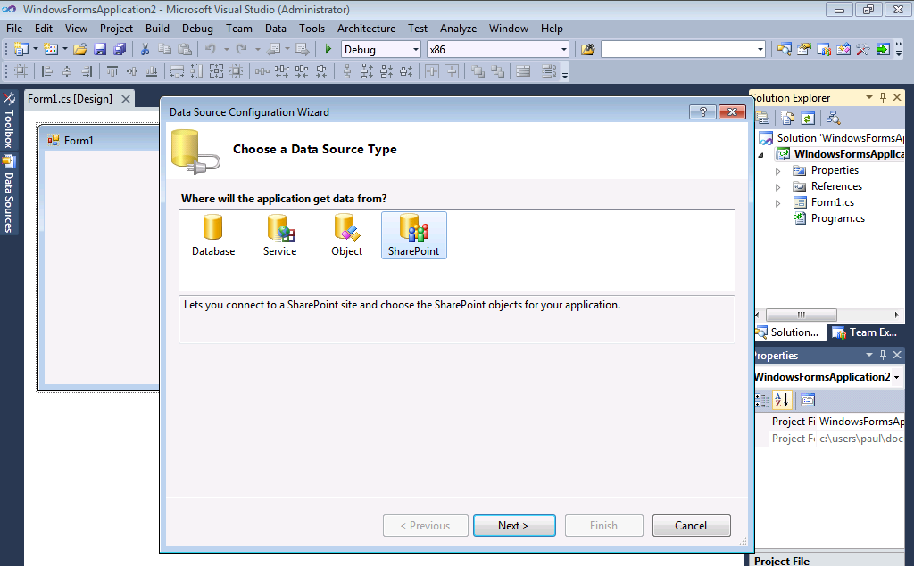
REST APIs
ADO.NET Data Services REST Protocols Atom, JSON feeds
SharePoint list data and Excel spreadsheets
Integration with growing set of Microsoft REST Technologies
Notes:
Work with data via REST
SharePoint list data
Excel spreadsheets
ADO.NET Services OpenData REST based integration
REST Protocols
Atom, JSON feeds
Integration with growing set of Microsoft REST Technologies
ASP.NET AJAX

Slide 22
REST APIs URI Map - Entity Properties
Syntax:
/_vti_bin/ListData.svc/{Entity}[({identifier})]/[{Property}]
Example to get budget hours for Project #4:
/_vit_bin/ListData.svc/Projects(4)/BudgetHours

Slide 23
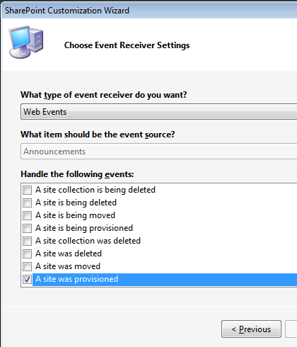
SharePoint Events Improvements Reacting to Server Events
Events Project Templates in Visual Studio 2010
After-Synchronous Events
Simpler Event Behavior
Site-scoped events
Web creation events
List creation events
More User Interface Control
Custom Error Pages
Notes:
Some new events were added like the after-synchronous event which is fired just after the update of a list item's properties and just before the user actually sees the new data
After events do not support cancellation of the user action. There are two types of event processing that can occur when an After event is raised: synchronous and asynchronous. Synchronous processing provides the ability to run the event in the same thread before sending the Web response back to the browser. Asynchronous event receivers are processed by a separate thread, so processing does not block the flow of code execution. The separate job thread for asynchronous processing is started by methods that reside in classes other than the SPEventReceiverDefinition class

Slide 24
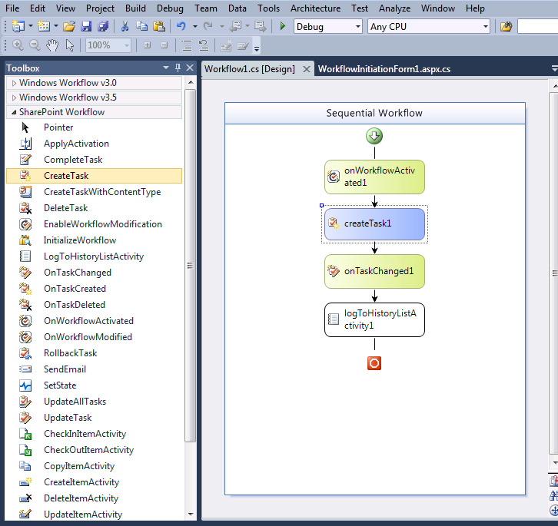
Workflow Improvements Popular and Successful Base in 2007
Visual Studio 2010 Initiation and Association Forms
Import SPD Workflows into Visual Studio
Build SPD Actions in Visual Studio
Visio 2010 Workflow Design
Site Workflows
Reusable Declarative Workflows

Slide 25
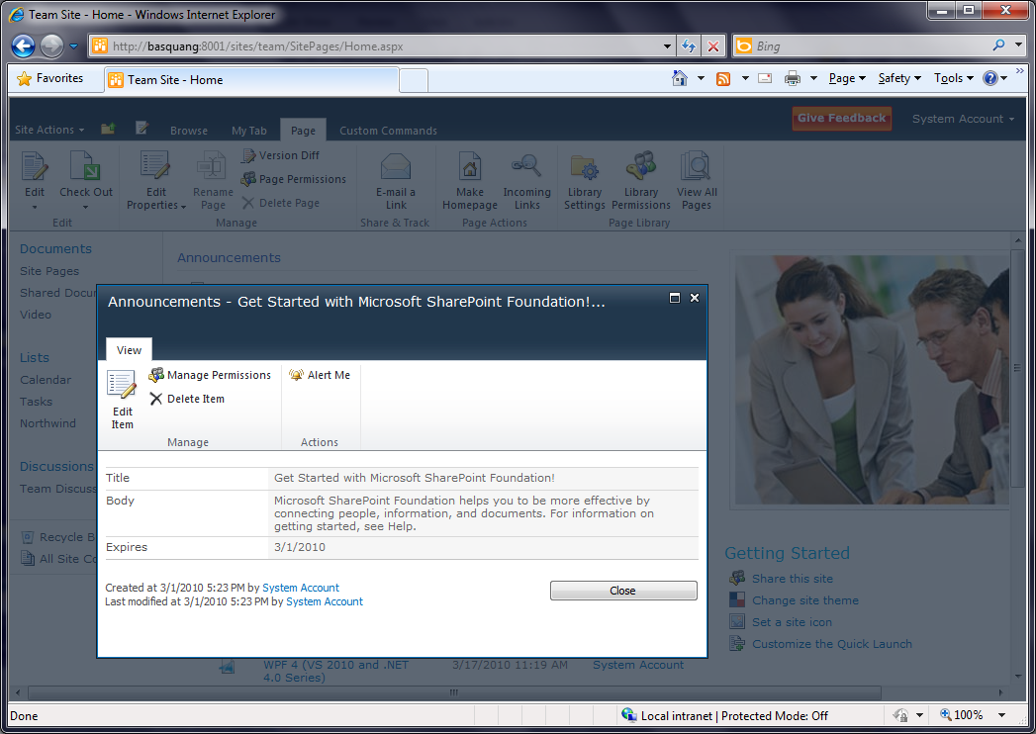
Modern, Extensible UI

Slide 26
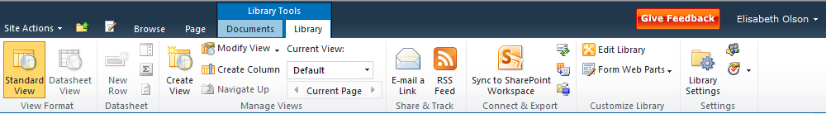
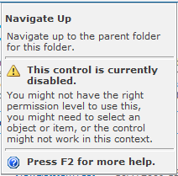
The Ribbon Design
Fixed position at top of page – doesn’t scroll out of view
Contextual tab model
Controls: near parity with Client Ribbon
Super tool tips

Slide 27
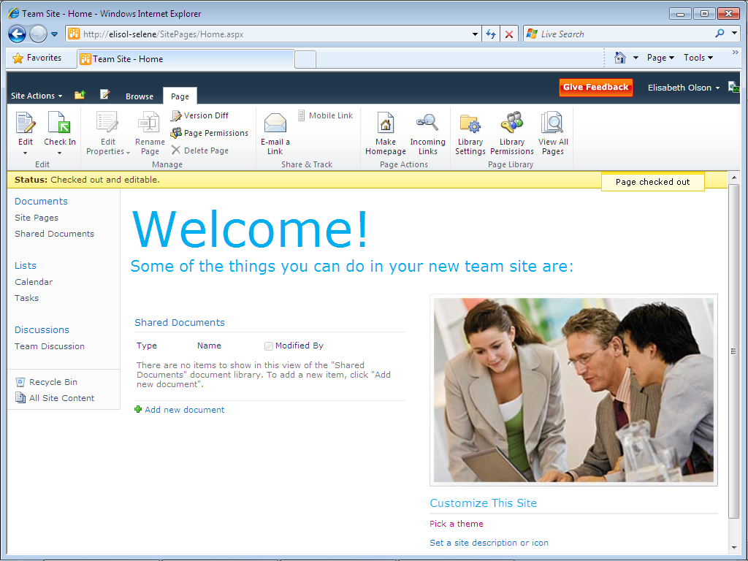
Ribbon and Dialog Framework
Client Site Custom Actions in Ribbon
Context Sensitive Ribbon
The Ribbon
Status Bar
Notification Area

Slide 28
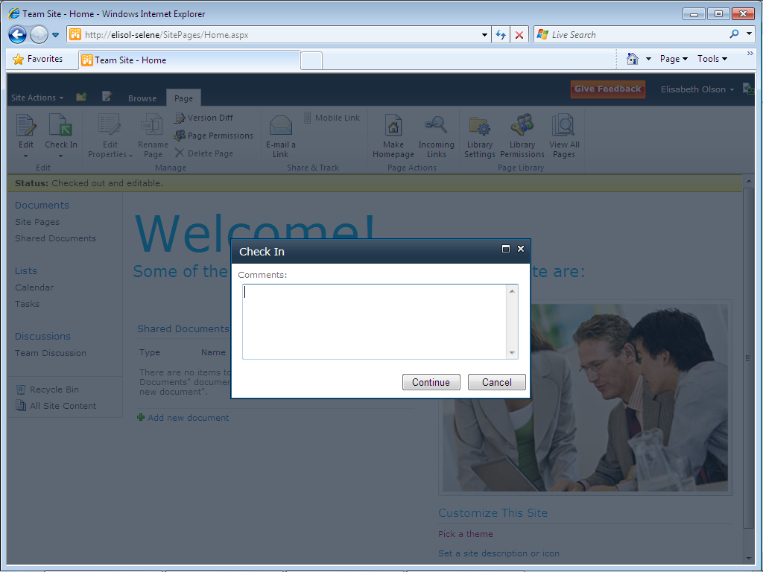

Ribbon and Dialog Framework
Replaceable SharePoint OOB forms
Open as Web Page or as Dialog
Dialog Framework

Slide 29
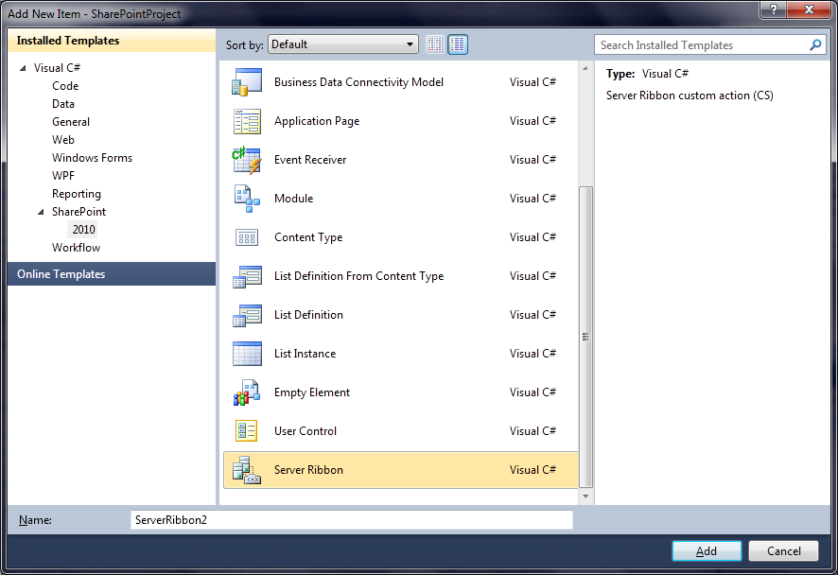
New Server Ribbon Item in Visual Studio Item Templates

Slide 30
Example Code to Add a Ribbon Button
<CustomAction
Id=“HelloWorldRibbonButtonDemo"
RegistrationType="List"
RegistrationId="101"
Location=“CommandUI.Ribbon">
<CommandUIExtension>
<CommandUIDefinitions>
<CommandUIDefinition
Location="Ribbon.Documents.New.Controls._children">
<Button
Id="Ribbon.Documents.New.DemoButton"
Alt=“Hello World Button"
Sequence="15"
Command="Demo_Hello_World"
Image32by32="/_layouts/MyButtonIcons/Demo1.png"
LabelText=“Hello World"
TemplateAlias="o1"/>
</CommandUIDefinition>
</CommandUIDefinitions>
<CommandUIHandlers>
<CommandUIHandler
Command=“Demo_Hello_World"
CommandAction=“javascript:alert(‘Hello World’);" />
</CommandUIHandlers>
</CommandUIExtension>
</CustomAction>

Slide 31
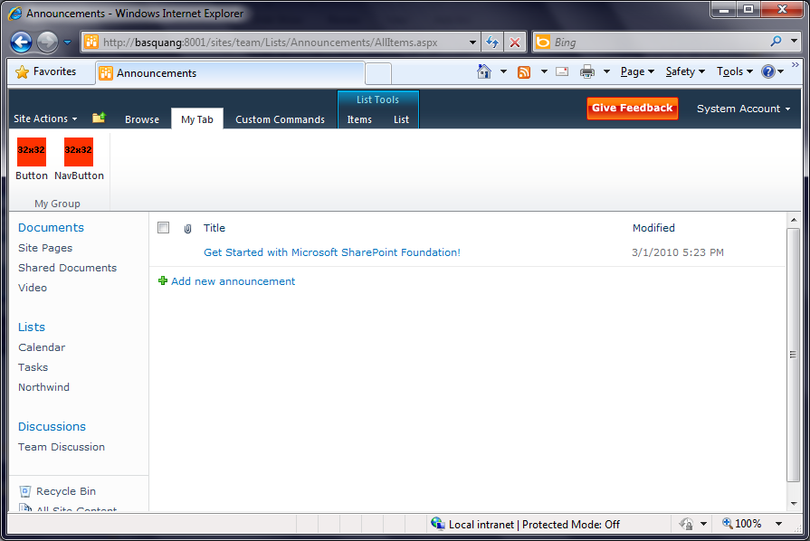
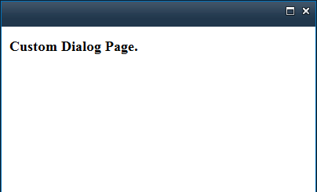
Simple Ribbon Tab

Slide 32
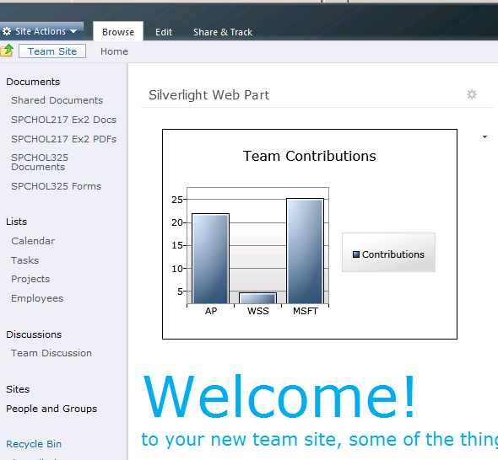
Silverlight 3 and SharePoint 2010 New UI Option
Media Player Web Part
Silverlight Web Part
Simple way to upload
Silverlight CLR compatible
Client Object Model
Call SharePoint API’s
REST APIs
Simplifies List data access

Slide 33
Hosting Silverlight Applications
The Silverlight XAP file can be deployed to a location
Such as _layouts/ClientBin
The Silverlight XAP can be uploaded to a SharePoint document library by an information worker
The built in Silverlight Web Part can be added to a page
URL property points to the XAP file

Slide 34
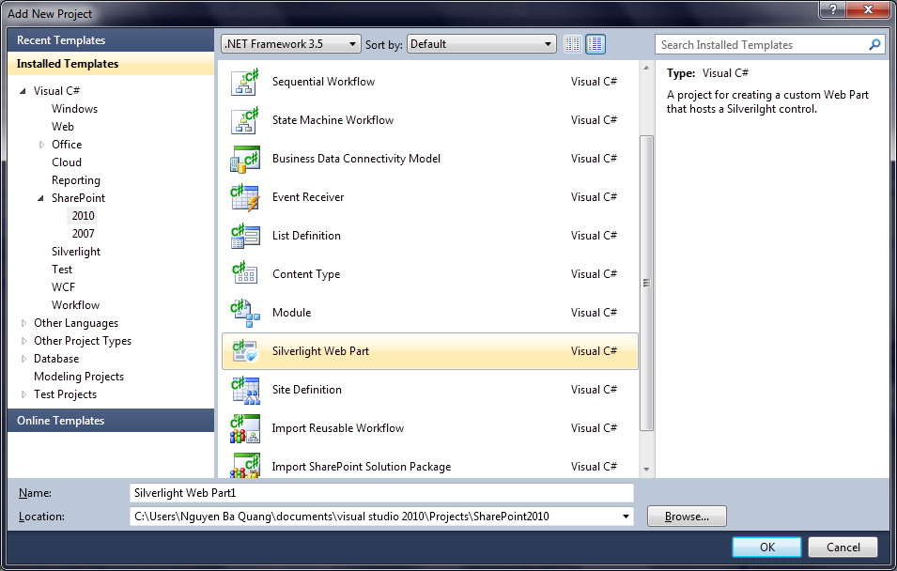
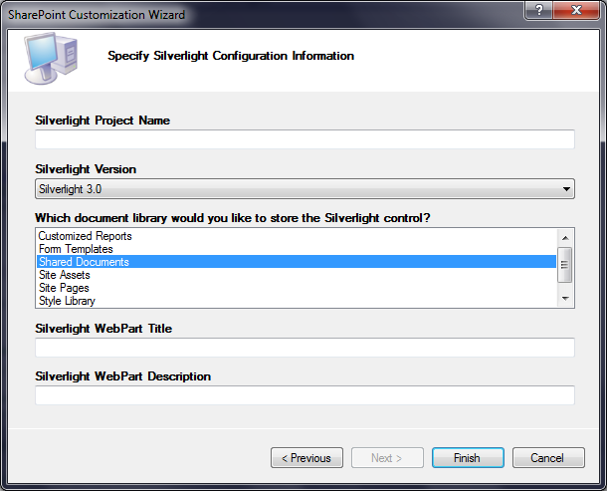
New project type Silverlight Web Part in Visual Studio Project templates

Slide 35
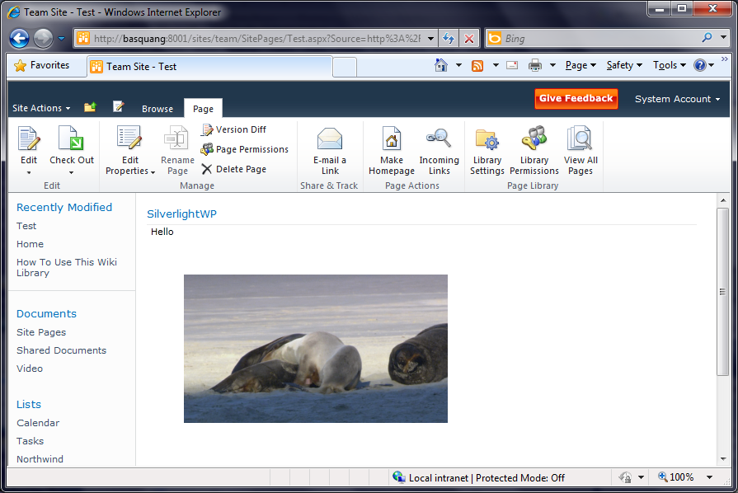
Simple Silverlight Web Part

Slide 36





Business Connectivity Services
Office Applications
BCS Client
Design Tools
SharePoint
Dev Platform
Business Intelligence
Enterprise Content Management
Collaboration Social
Enterprise Search
SharePointDesigner
External Lists
Visual Studio
External Content Type Repository
Business Data Connectivity
LOB
Web Service
WCF
DB
Web 2.0

Slide 37


Investment Areas
Extend Office and SharePoint‘s UX and capabilities to external data and processes
Presentation
Read-write capable connectivity from client and server to databases, WCF/WebServices and .NET sources
Connectivity
Integrated tooling experience scales from simple solutions to advanced pro-dev apps with rich client packaging and deployment
Tooling

Slide 38



External Content Types
The Building Block
Describes the schema and data access capabilities of an external data source and its behavior within Office and SharePoint
*formerly known as BDC Entity
Office Clients (Rich)
BCS
External Data Source
(Web Service, DB, .Net object, LOB system, Web 2.0 service, etc.)
External Content Type (ECT)
BCS
BCS-enabled solutions rely on ECTs to integrate external data into SharePoint and the Office client applications
SharePoint (Thin)
Notes:
- BCS-enabled solutions rely on ECTs to integrate external data into Office and SharePoint on client and server

Slide 39
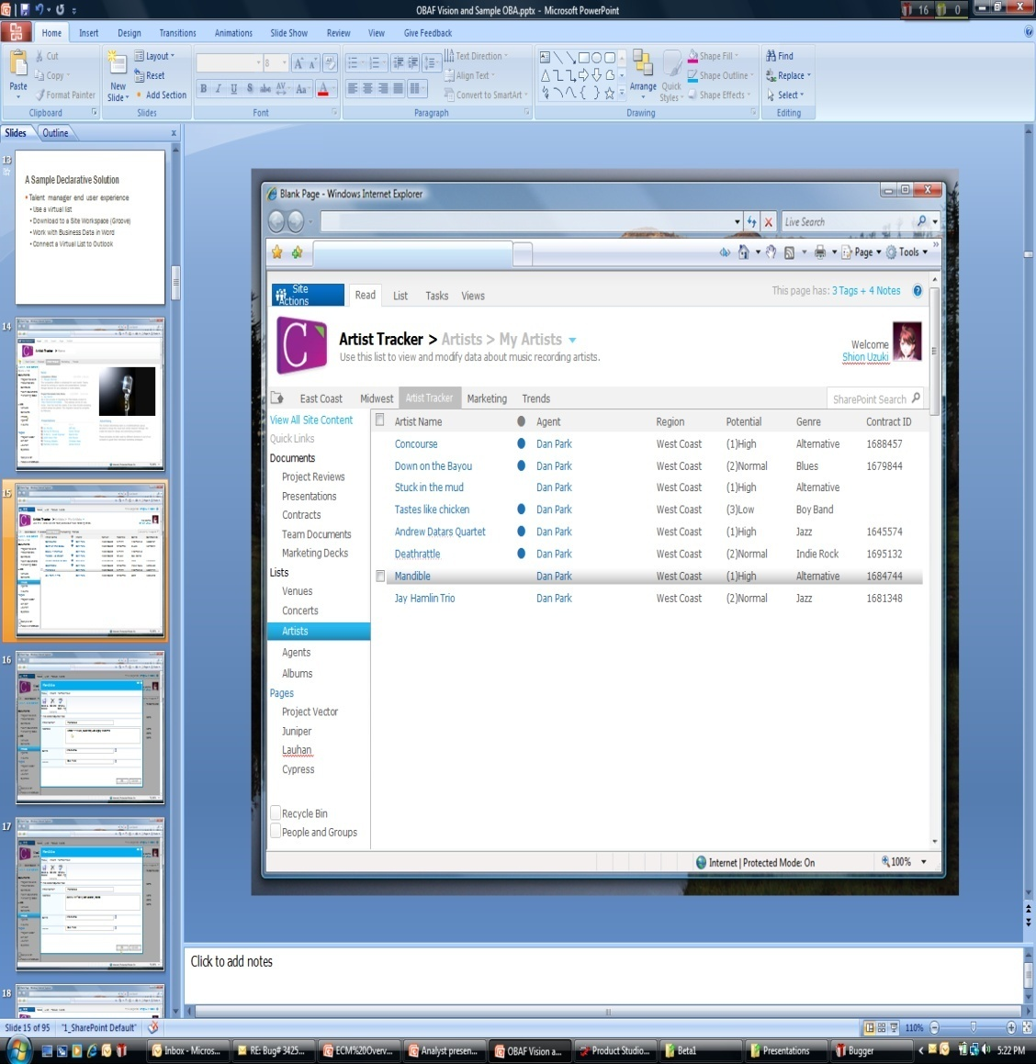
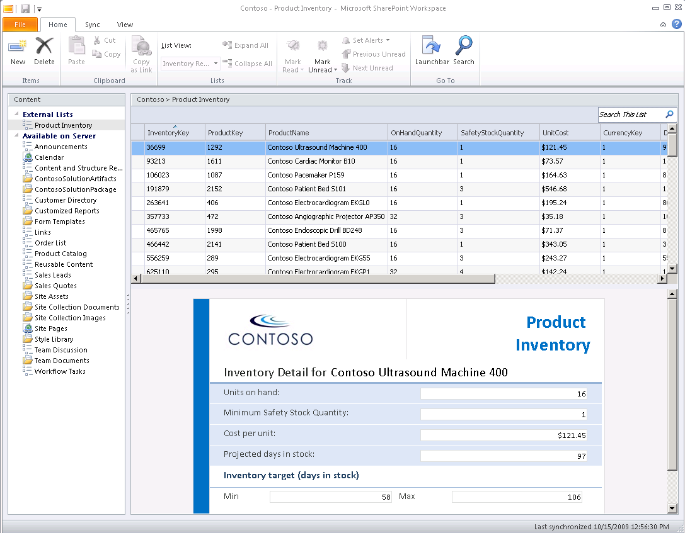
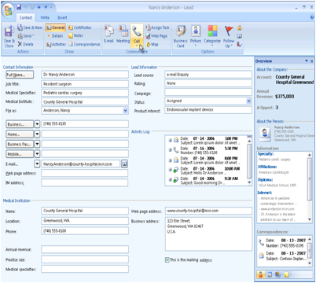
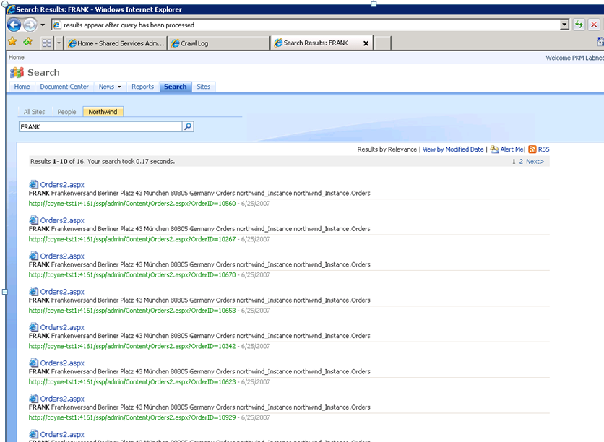
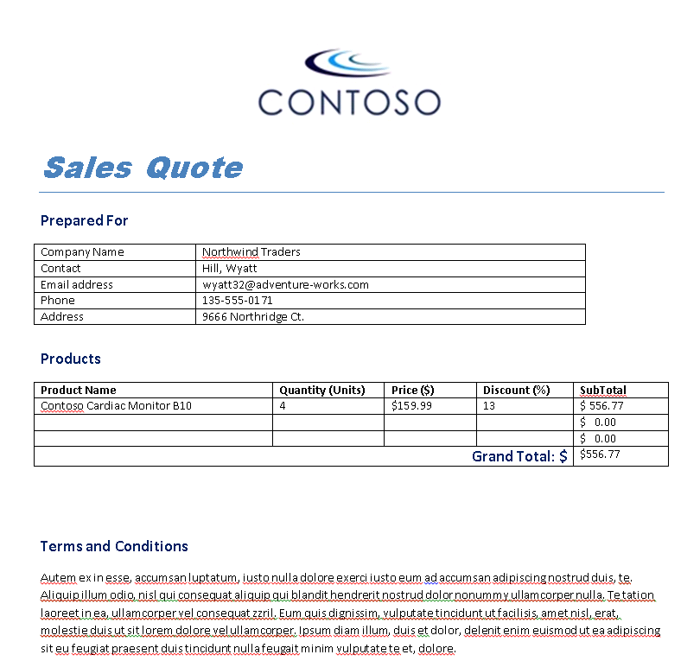
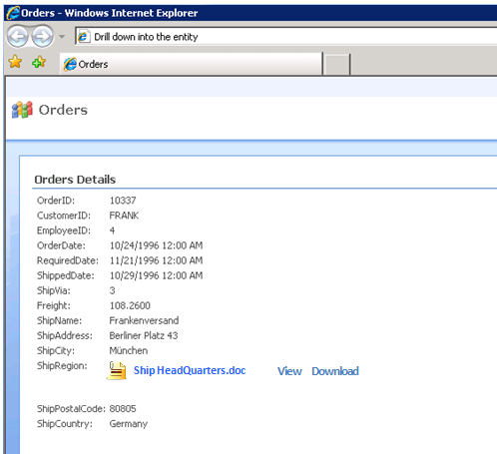
External Content Type The building block
SharePoint External Lists
SharePoint Workspace with InfoPath Forms
Outlook Forms and Task Panes
External Content Type
Customer
CustomerID
FirstName
LastName
EmailAddress
Search Results
External data
Office Applications

Slide 40
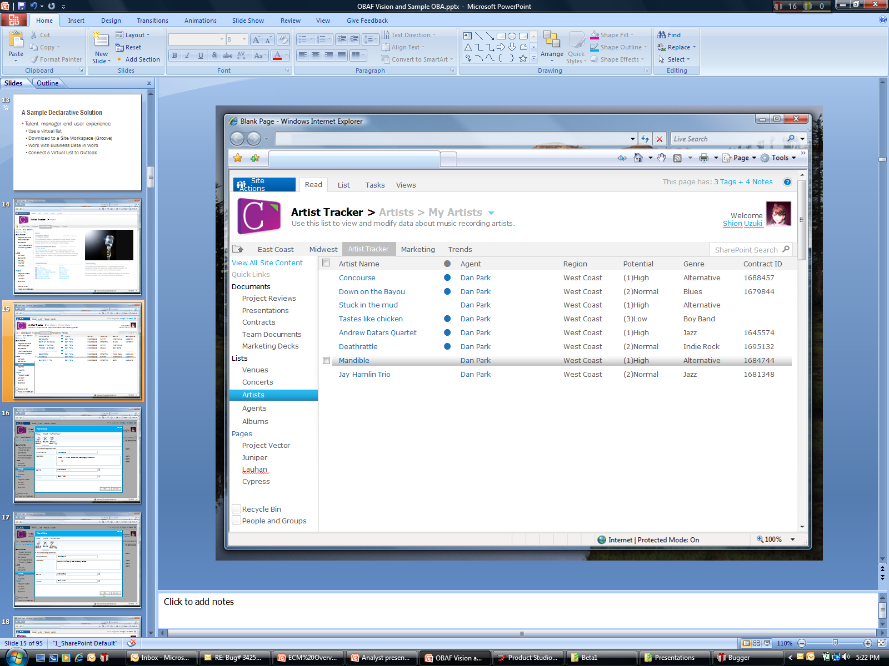
External Lists in SharePoint
Expose external data as a native SharePoint list
Full CRUD capability
Familiar UI and navigation
Sort, Filter, Group
Programmatic access via SPList OM
Profile page available for each item in the list
Form
Auto-generated OOB
Upsize to InfoPath
Offline-able

Slide 41
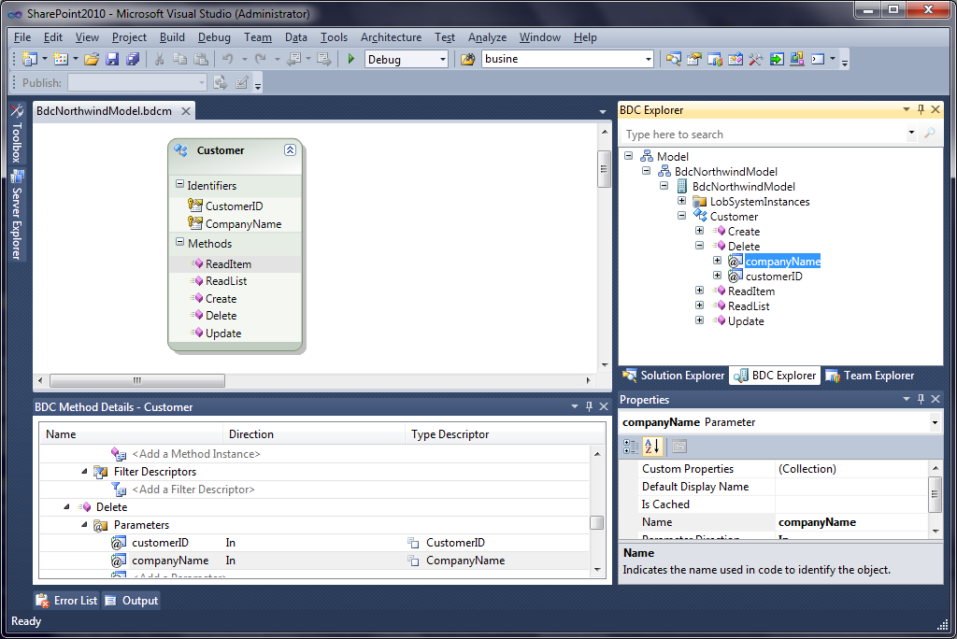
Visual Studio 2010 Support
The tool for creating .NET Assembly Connectors
Notes:
Visual Studio 2010 BDC Designer allows you to develop, debug and deploy Business Data Connectivity Models using the External System type “.NET Assembly Connector”. This type is used for:
Aggregation scenarios (across back-ends, across multiple calls to same backend, read from one back-end write to another)
Custom/Complex Data Transformations,
Custom Security (e.g. where SSO falls short)
Custom Business Logic/Rules needed outside the back-end (don’t have good example of this)
In addition Visual Studio 2010 BDC designer allows to import models created by SPD customize them, package them and deploy them through the Visual Studio

Slide 42
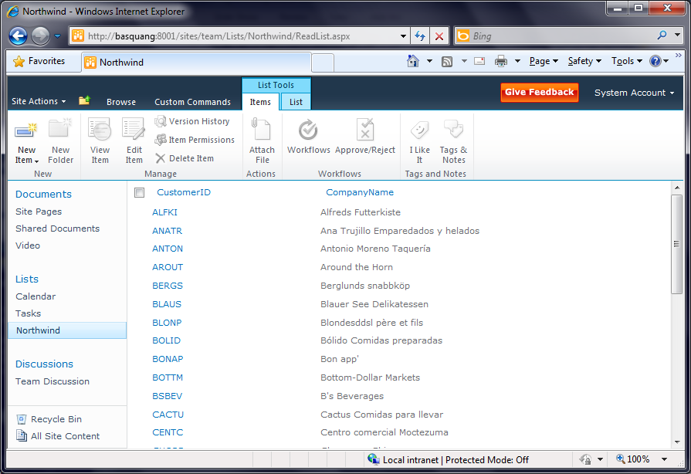
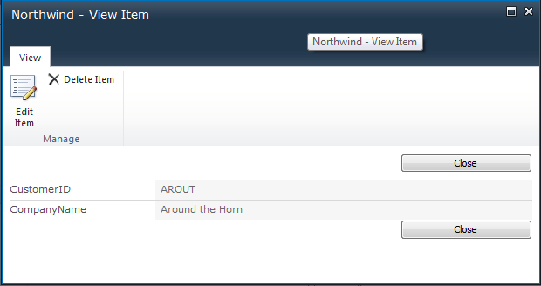
Northwind External List

Slide 43
Summary - Business Connectivity Services
Read/Write access to the LOB data
Available in SharePoint Foundation (new WSS name), too
BDC Entity Designer in VS2010
The data are surfaced as External Content Type in SharePoint list templates
Monitored by Service Applications option in Central Admin

Slide 44
You’ve created a great collaboration app!
but...
‘Bad’ code can cause performance, reliability headaches
So, deploying code requires server admin audits and blessing
Therefore, in large-scale hosted environments, deploying code is impossible

Slide 45
Sandboxed Solutions
Security & Stability
Security & Stability
Business Agility
Business Agility
Essential Agility
Essential Stability
Easy Deployment
Iterative Development
Access To Shared Servers
SharePoint Online
Safe for Other Users
Limited API Access
Monitored Resources
Separate Process
Site Collection Limits
Notes:
Sandbox solution is a pretty powerful idea. Oftentimes I've wanted to try out a Web Part that I'd come across on the Web, or just wanted to test one of our own Bamboo Web Parts, and the only way I could try it out in SharePoint 2007 was by deploying it in my virtual environment. This is mainly required because I need farm admin rights to use STSADM deployment. With the sandbox feature I can now be a site collection admin and can still deploy the WSP package. This is good news for developers like me, because now I can quickly deploy a Web Part for testing in my MySite site on our company's portal without breaking anything. This should be quick and easy and could simplify the lives of many. At least in theory.

Slide 46
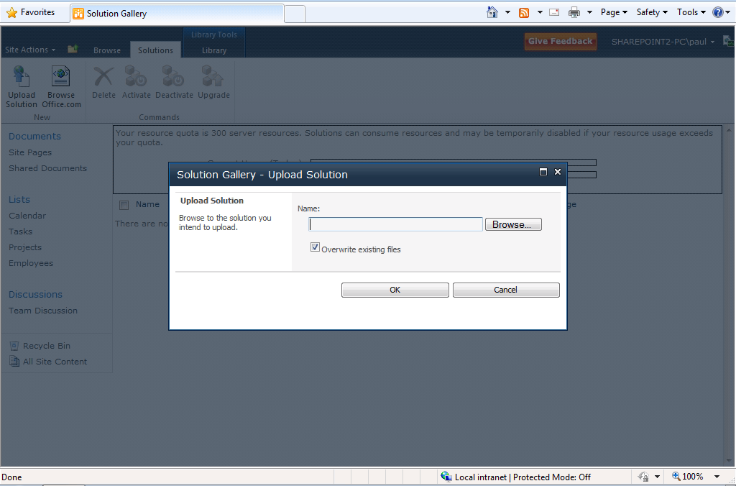
SharePoint Online
Upload Sandboxed Solution WSP

Slide 47
demo

Slide 48

© 2009 Microsoft Corporation. All rights reserved. Microsoft, Windows, Windows Vista and other product names are or may be registered trademarks and/or trademarks in the U.S. and/or other countries.
The information herein is for informational purposes only and represents the current view of Microsoft Corporation as of the date of this presentation. Because Microsoft must respond to changing market conditions, it should not be interpreted to be a commitment on the part of Microsoft, and Microsoft cannot guarantee the accuracy of any information provided after the date of this presentation. MICROSOFT MAKES NO WARRANTIES, EXPRESS, IMPLIED OR STATUTORY, AS TO THE INFORMATION IN THIS PRESENTATION.

